Slide 1
Model Calibration
Cost-Effectiveness and Decision Modeling in R Workshop
University of Minnesota School of Public Health
July 23 – 26, 2018

Slide 2
Motivation
Mathematical models of disease often involve a subset of parameters whose values are unknown
Common reasons include physical, feasibility, and ethical limitations
Estimate values for these parameters by matching model outputs to observed outcomes
Model calibration

Slide 3
Calibration definition
Process of adjusting model input parameter values to match data on an outcome of interest (e.g., survival, prevalence, or incidence)
Outcome(s) of interest = “calibration targets”

Slide 4
Calibration Process
KNOWN PARAMETERS
MODEL
OBSERVABLE HEALTH OUTCOMES
UNKNOWN PARAMETERS
Try different sets of parameter values
Compare against calibration targets
(Calculate “fit”)
Repeat to find “best-fitting”
set of parameter values

Slide 5
Calibration Targets
Empirical data to be replicated by the model
Summary statistics (e.g. mean age of cancer diagnosis) or series of observations (e.g. age-specific incidence)
Can calibrate to multiple targets (e.g. survival and prevalence) simultaneously
Model should be able to output the outcomes of interest

Slide 6
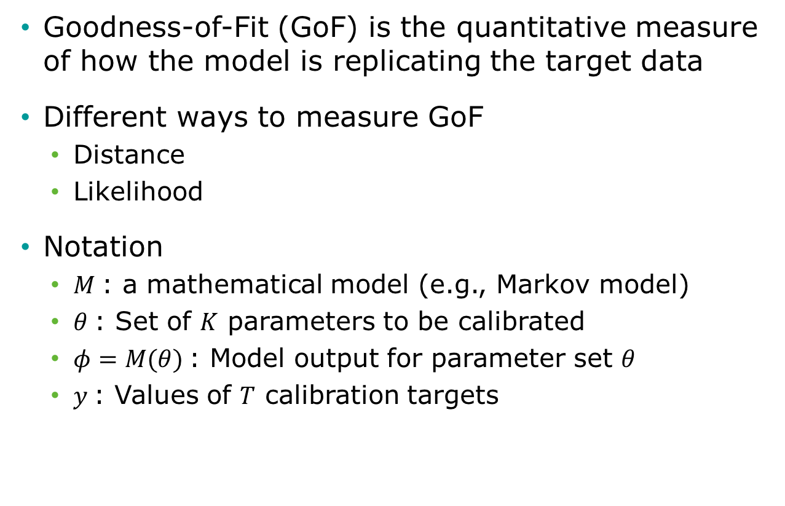
Calculating “fit”
Goodness-of-Fit (GoF) is the quantitative measure of how the model is replicating the target data
Different ways to measure GoF
Distance
Likelihood
Notation
$M$: a mathematical model (e.g., Markov model)
$θ$: Set of $K$ parameters to be calibrated
$φ=M(θ)$: Model output for parameter set $θ$
$y$: Values of $T$ calibration targets

Slide 7
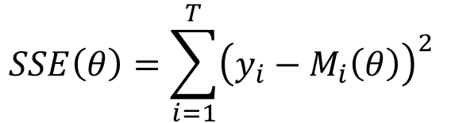

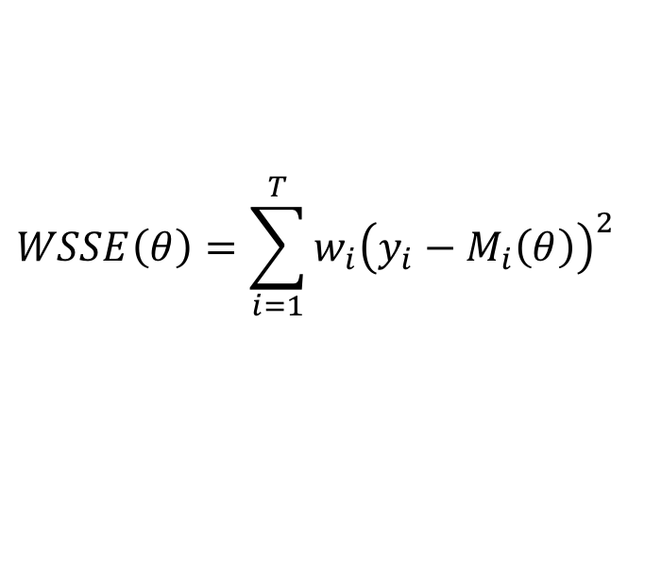
Distance GoF measures
Sum of squared errors
Weighted sum of squared errors
Assign different weight to different targets ($w_{i}$)
Often, $w_{i}=\frac{1}{σ^{2}}$
$$SSE\left(θ\right)=\sum_{i=1}^{T}{{\left(y_{i}−M_{i}\left(θ\right)\right)}^{2} }$$
$$WSSE\left(θ\right)=\sum_{i=1}^{T}{{w_{i}\left(y_{i}−M_{i}\left(θ\right)\right)}^{2} }$$

Slide 8
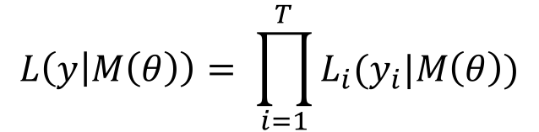
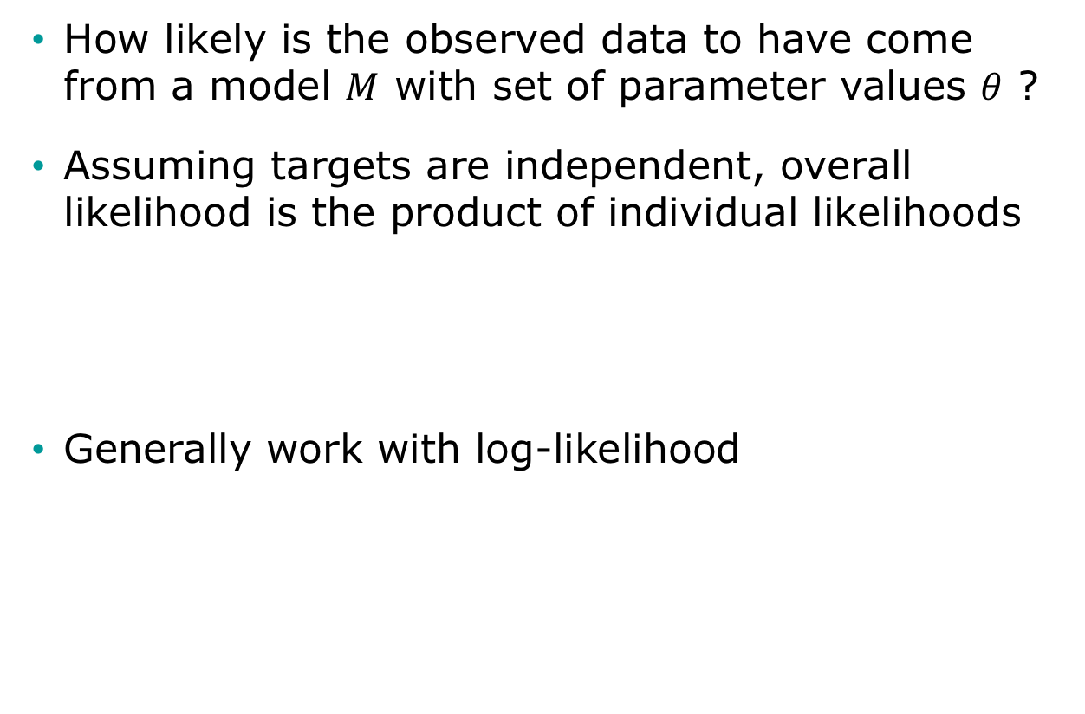
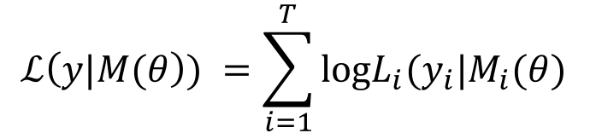
Likelihood as GoF
How likely is the observed data to have come from a model $M$ with set of parameter values $θ$ ?
Assuming targets are independent, overall likelihood is the product of individual likelihoods
Generally work with log-likelihood
$$L\left(y | M\left(θ\right)\right)= \prod_{i=1}^{T}{L_{i}(y_{i}|M\left(θ\right))}$$
$$ℒ\left(y|M(θ\right)) =\sum_{i=1}^{T}{\text{log}L_{i}(y_{i}|M_{i}(θ) }$$

Slide 9
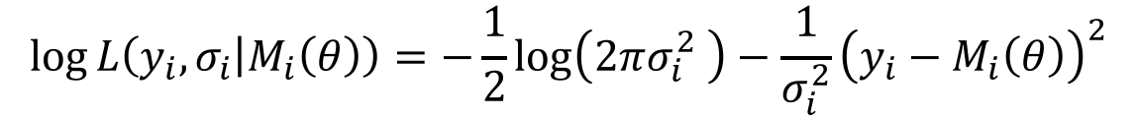
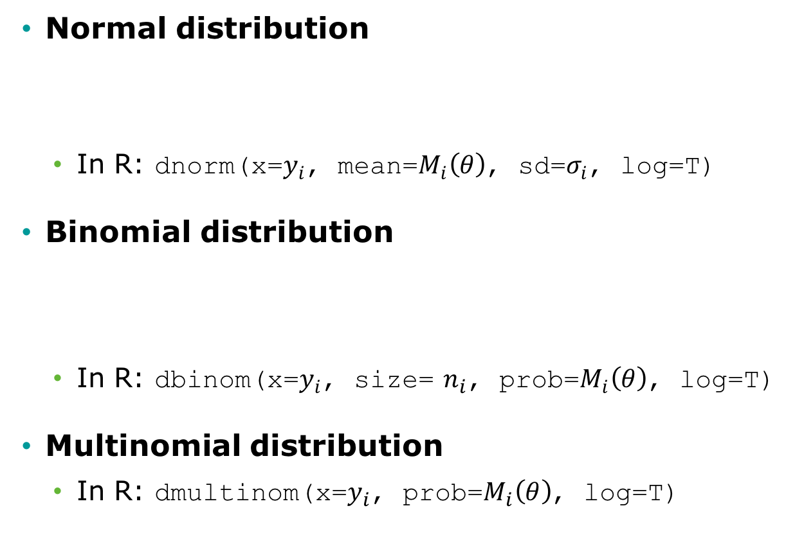
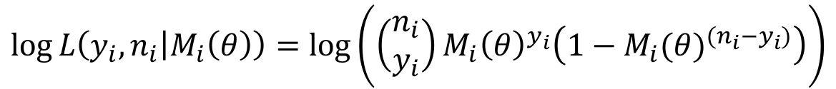
Commonly used likelihoods
Normal distribution
In R: dnorm(x=$y_{i}$, mean=$M_{i}\left(θ\right)$, sd=$σ_{i}$, log=T)
Binomial distribution
In R: dbinom(x=$y_{i}$, size= $n_{i}$, prob=$M_{i}\left(θ\right)$, log=T)
Multinomial distribution
In R: dmultinom(x=$y_{i}$, prob=$M_{i}\left(θ\right)$, log=T)
$$\log{L\left(y_{i},σ_{i} | M_{i}\left(θ\right)\right)}=−\frac{1}{2}\log\left(2πσ_{i}^{2} \right)−\frac{1}{σ_{i}^{2}}{\left(y_{i}−M_{i}\left(θ\right)\right)}^{2}$$
$$\log{L\left(y_{i},n_{i} | M_{i}\left(θ\right)\right)}=log⁡\left(\left(\begin{matrix}n_{i} \\ y_{i}\end{matrix}\right){M_{i}\left(θ\right)}^{y_{i}}\left(1−{M_{i}(θ)}^{(n_{i}−y_{i})}\right)\right)$$

Slide 10
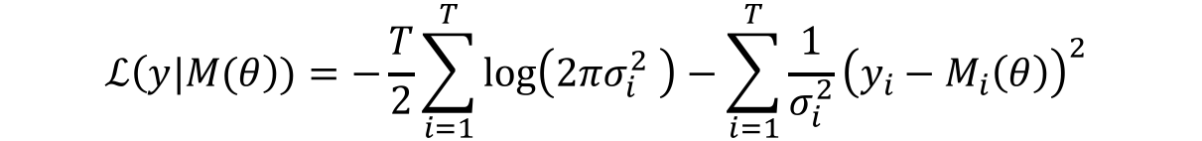

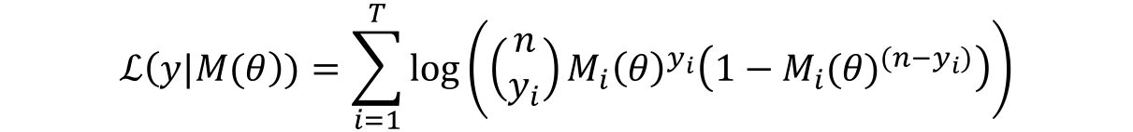
Commonly used likelihoods
Normal distribution
In R: dnorm(x=$y_{i}$, mean=$M_{i}\left(θ\right)$, sd=$σ_{i}$, log=T)
Binomial distribution
In R: dbinom(x=$y_{i}$, size=1, prob=$M_{i}\left(θ\right)$, log=T)
Multinomial distribution
In R: dmultinom(x=$y_{i}$, prob=$M_{i}\left(θ\right)$, log=T)
$$ℒ\left(y|M(θ\right))=−\frac{T}{2}\sum_{i=1}^{T}{\log\left(2πσ_{i}^{2} \right)}−\sum_{i=1}^{T}{\frac{1}{σ_{i}^{2}}{\left(y_{i}−M_{i}\left(θ\right)\right)}^{2} }$$
$$ℒ\left(y|M(θ\right))=\sum_{i=1}^{T}{\log\left(\left(\begin{matrix}n \\ y_{i}\end{matrix}\right){M_{i}\left(θ\right)}^{y_{i}}\left(1−{M_{i}(θ)}^{(n−y_{i})}\right)\right)}$$

Slide 11
Search Strategy
Define plausible ranges for parameter whose values are unknown
Use a search strategy to “search” through the input parameter space
Run the model for sets of parameter values generated by search strategy
Parameter space

Slide 12
Grid Search
Run model for all possible combinations of parameter values
Often infeasible

Slide 13
Random Search
Randomly sample a large number of parameter value sets
Use "Latin hypercube sampling” (LHS) to ensure sample captures the full parameter space
Random sample

Slide 14
Random Search
Randomly sample a large number of parameter value sets
Use "Latin hypercube sampling” (LHS) to ensure sample captures the full parameter space
LHS sample

Slide 15
Iterative Search
Use fits of past input values to determine which input values to try next
Directed methods
Nelder-Mead (simplex method)
Gradient–descent and others
Meta-heuristic algorithms
Genetic algorithms
Simulated annealing
Markov Chain Montel Carlo
Coupled with a likelihood-based measure of fit to conduct a Bayesian calibration

Slide 16
Nelder-Mead Algorithm
Downhill simplex method
Must be run multiple times for different starting points to avoid local extrema
starting point
final value
search path

Slide 17
Example: Calibrating a 3-state cancer model
Notes:
Part 1 = Showing code 3 state model
Part 2 = Exercise build Sick-Sicker model
Part 3 = Show answers of Sick-Sicker

Slide 18
3-state cancer model
Relative survival as reported by the Surveillance, Epidemiology, and End Results (SEER) Program, represents cancer survival in the absence of other causes of death
Cancer Markov models often have a distant metastasis state, a state not directly observed in SEER, from which cancer deaths are presumed to occur
These models are used to model interventions that affect transitions to and from this state
Alarid-Escudero, F., Maclehose, R. F., Peralta, Y., Kuntz, K. M., & Enns, E. A. (2018). Non-identifiability in model calibration and implications for medical decision making. Medical Decision Making, In Press.

Slide 19
3-state cancer model
Two unknown transition probabilities
p.Mets: Monthly risk of developing distant recurrence, range = [0.04, 0.16]
p.DieMets: Monthly risk of cancer death, range = [0.04, 0.16]

Slide 20
Target: Relative survival
Data frame “Surv” stored in datafile “CRSTargets.Rdata”

Slide 21
Calibration specification
Goodness-of-fit measure
Sample size and standard deviation of each target is given in target data frame “Surv”
We will cover how to implement both weighted sum of squared errors and log-likelihood GoF measures
Search strategy
Latin-hypercube random sampling (10,000 samples)
We’ll also show how to use Nelder-Mead

Slide 22
Calibration Code Structure
Setup Markov model as a function
Inputs: parameter values
Outputs: outcomes to be compared against calibration targets
Write function to compute goodness-of-fit
Inputs: set of values for parameters to be calibrated
Outputs: goodness-of-fit for the resulting model outcomes to the calibration targets
Randomly sample values for parameters to be calibrated and run goodness-of-fit function for each set
Identify the set of parameter values that achieves the best goodness-of-fit
Find best set using a directed search approach

Slide 23
R Session
Notes:
Part 1 = Showing code 3 state model
Part 2 = Exercise build Sick-Sicker model
Part 3 = Show answers of Sick-Sicker

Slide 24
Bayesian calibration
Notes:
Part 1 = Showing code 3 state model
Part 2 = Exercise build Sick-Sicker model
Part 3 = Show answers of Sick-Sicker

Slide 25
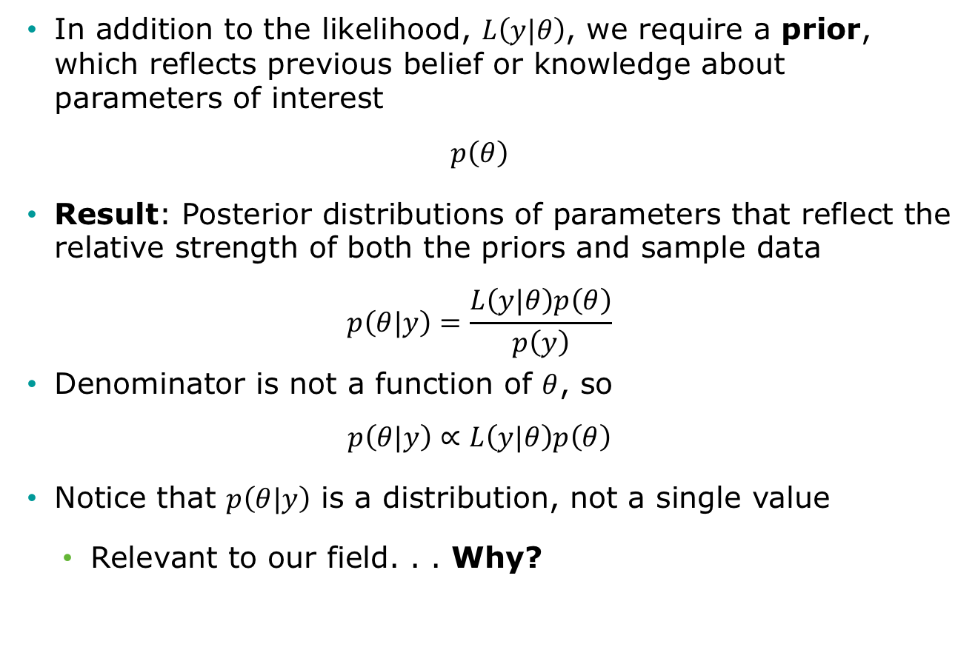
Bayesian setup
In addition to the likelihood, $L\left(y|θ\right)$, we require a prior, which reflects previous belief or knowledge about parameters of interest
$$p\left(θ\right)$$
Result: Posterior distributions of parameters that reflect the relative strength of both the priors and sample data
$$p\left(θ|y\right)=\frac{L\left(y|θ\right)p\left(θ\right)}{p\left(y\right)}$$
Denominator is not a function of $θ$, so
$$p\left(θ|y\right)∝L\left(y|θ\right)p\left(θ\right)$$
Notice that $p\left(θ|y\right)$ is a distribution, not a single value
Relevant to our field. . . Why?

Slide 26
Pros and cons
Pros: We obtain distributions of parameters rather than only point estimates
Cons: “Harder” to implement than other methods? Mmm not really!
Different methods to obtain posterior distributions
Analytically (not so feasible with simulation models)
Monte Carlo methods
Sampling methods (a significant amount of algorithms!):
Sampling Importance Resampling (SIR)
Incremental Mixture Importance Sampling (IMIS)
Markov chain Monte Carlo (MCMC)

Slide 27
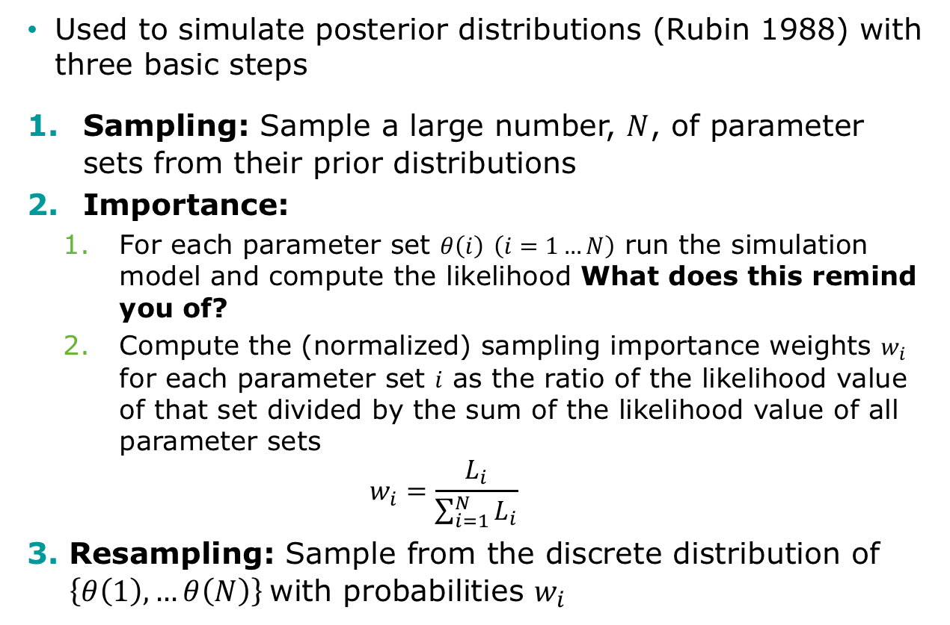
Sampling Importance Resampling (SIR)
Used to simulate posterior distributions (Rubin 1988) with three basic steps
Sampling: Sample a large number, $N$, of parameter sets from their prior distributions
Importance:
For each parameter set $θ\left(i\right)$ $\left(i=1…N\right)$ run the simulation model and compute the likelihood What does this remind you of?
Compute the (normalized) sampling importance weights $w_{i}$ for each parameter set $i$ as the ratio of the likelihood value of that set divided by the sum of the likelihood value of all parameter sets
$$w_{i}=\frac{L_{i}}{\sum_{i=1}^{N}{L_{i}}}$$
Resampling: Sample from the discrete distribution of $\left\{θ\left(1\right), …θ\left(N\right)\right\}$with probabilities $w_{i}$

Slide 28
Incremental Mixture Importance Sampling (IMIS)

Slide 29
Markov chain Monte Carlo (MCMC)
Used to simulate posterior distributions (Rubin 1988) with three basic steps
Sampling: Sample a large number, $N$, of parameter sets from their prior distributions
Importance:
For each parameter set $θ\left(i\right)$ $\left(i=1…N\right)$ run the simulation model and compute the likelihood What does this remind you of?
Compute the (normalized) sampling importance weights $w_{i}$ for each parameter set $i$ as the ratio of the likelihood value of that set divided by the sum of the likelihood value of all parameter sets
$$w_{i}=\frac{L_{i}}{\sum_{i=1}^{N}{L_{i}}}$$
Resampling: Sample from the discrete distribution of $\left\{θ\left(1\right), …θ\left(N\right)\right\}$with probabilities $w_{i}$

